Slide 1

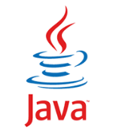
COMP1030 Lecture #6
Introduction to java

Slide 2
Housekeeping
Our goal - 100% pass rate in this course.
Review the lecture slides ahead of time.
Review the lecture slides after class with a study group.
Repeat the lab at home 1-2 times.
Take notes during class.
Weekly optional tutorials take place every week on Wednesdays, from 3-4pm in room N111 (note new location.
The four secrets of success

Slide 3
Housekeeping
Assignment #1 Answer key is posted under the assignments link
Misterm-Exam question paper and answer key are posted under course information link
Mid-term exams can be photographed during todays lab
Labs will no longer be checked as homework
Students will be expected to work in a lab group – be prepared to change seats for lab

Slide 4
Review
for statement
do-while statement
switch statement

Slide 5
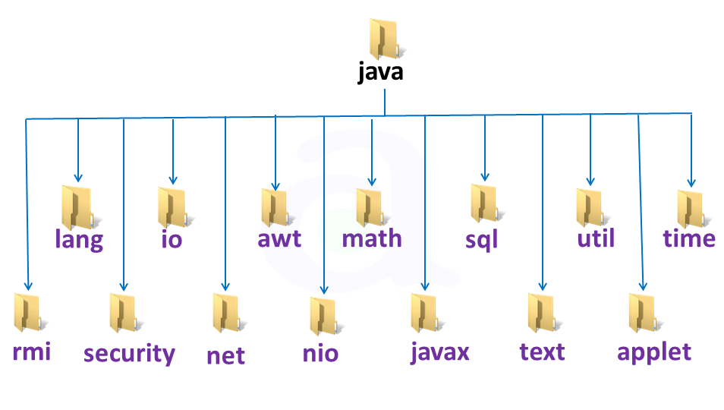
Software re-usability
Java packages

Slide 6
Software re-usability
Use existing classes from existing java packages to reduce development time and programming errors
Dividing a program into meaningful classes and methods avoids re-writing code and supports easier debugging and maintenance

Slide 7
Software re-usability
Every method should be limited to performing a single well defined task.
The name of the method should express its task.

Slide 8
Static methods and fields
Called class methods
Do not require an object to be invoked
To declare a method as static place the keyword static before the return type in the methods declaration

Slide 9
Static methods and fields
A static method can be called (invoked) using the class name and the dot operator:
ClassName.methodName (arguments)

Slide 10
Static methods and fields
The Math class provides several convenient static methods
Math.sqrt(900);

Slide 11
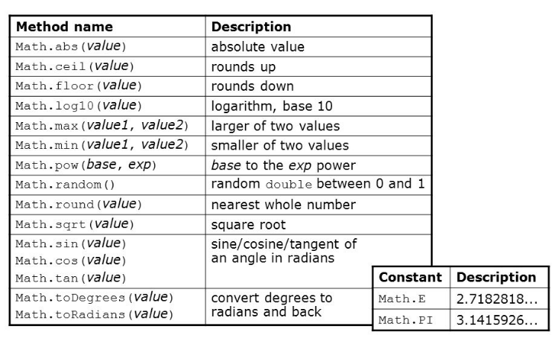
Static methods and fields
Some Math class methods

Slide 12
Static methods and fields
Math.max (x,y);
Math.max(32,45);
Math.max(x, Math.max(y,z));
this line of code finds the largest of three values

Slide 13
Static methods and fields
Static variables are also known as class variables.
All objects share one copy of static variables.
PI for example is declared: public static final
A final variable cannot be changed once
it is initialized.

Slide 14
Concatenation
The + operator can be used to assemble String objects into larger Strings
The + operator is a good illustration of polymorphism
“hello” + “world” --- + means concatenation
3 +4 --- + means plus

Slide 15
Concatenation
System.out.println(“Maximum is: “ + result);
Assuming result was an int, result was converted to a String by java and then concatenated to “Maximum is: “
Java evaluates the operands of an operator from left to right

Slide 16
Concatenation
Example
int y = 5;
System.out.println(“y+2=” + y + 2);
prints: y+2=52
why?

Slide 17
Concatenation
Example
int y = 5;
System.out.println(“y+2=” + (y + 2));
prints: y+2=7
why?

Slide 18
Method invocation
There are three ways to invoke a method:
A method in the same class can be called with just the method name. (no reference or dot operator)
Using a reference to the object and the dot operator. (instance method)
Using the class name and the dot
operator. (static method)

Slide 19
Method compiler errors
Static methods are typically not used to access instance variables or instance methods of the same class because an object may not yet be created.
Declaring a method outside the body of a class or inside the body of another method will result in a syntax error

Slide 20
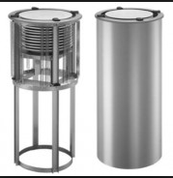
Method Call Stack
A stack is a data structure or collection of related data items.

Slide 21
Method Call Stack
When a plate (data) is placed on
top of the stack it is referred to
as “push”.
When a plate (data) is removed from the stack it is known as “pop”.
Most stacks are based upon a LIFO architecture.

Slide 22
Method Call Stack
When a program calls a method,
program execution leave its
current location and “jumps”
to another location in the code.
Once the method is completed, the program needs to know where it left off. The memory location of where it is left off is stored
on the stack.

Slide 23
Method Call Stack
If multiple method calls are made
in succession, the successive
return addresses are pushed onto
the stack in LIFO order.
However, the computers memory is finite
(recall modulus arithmetic), therefore
a finite number of successive method
calls can be accommodated. Too many
method calls will cause a stack overflow error.

Slide 24
Argument Promoting and Casting
The Math.sqrt() method expects a double argument.
However Math.sqrt(4); is valid because java will automatically promote (convert) the int 4 to a double because no data will be lost in this promotion.

Slide 25
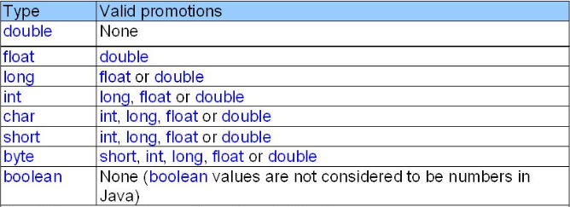
Argument Promoting and Casting
Promotions allowed for primitive types

Slide 26
Argument Promoting and Casting
Converting a double to an int will truncate the fractional portion of the double value, therefore part of the value is lost.
If one attempts to use a type that requires a demotion (converting to a lower type) the compiler will error out.
To force conversion (essentially saying to the compiler, I know this conversion might cause loss of information, but in this situation it is ok) we can use the cast operator.

Slide 27
Argument Promoting and Casting
Example
A method called calculateResult requires an argument of type int.
To pass a double we would need to cast the double to an int: (this is known as type casting)
ref.calculateResult((int)32.64);

Slide 28
Scope
The scope of a variable is the portion of the program that can refer to the declared variable by its name.
If a variable can be referred to by its name it is said to be in scope for that portion of the program.

Slide 29
General Scope Rules
The scope of a parameter declaration is the body of the method in which the declaration appears.
The scope of a local variable declaration is from the point at which the declaration appears to the end of that block.

Slide 30
General Scope Rules
The scope of a local variable declaration that appears in the initialization section of a statement header is the body of the for statement and the other expressions in the header.
A method or instance variable scope is the entire body of the class.

Slide 31
Method Overloading
Methods of the same name can be declared in the same class, as long as they have a different signature relative to the parameters.
# of parameters
Types of parameters
Order of parameters

Slide 32
Method Overloading
When the overloaded method is invoked, the compiler selects the appropriate method based upon the parameter list.
Example: the Math.max() method has 4 overloaded versions which take as parameters:
Two doubles
Two floats
Two longs
Two ints
A different return type does not constitute an overloaded
method.

Slide 33
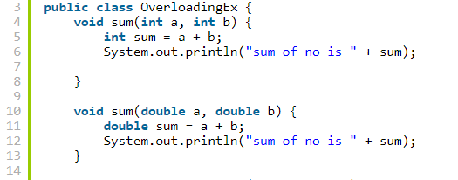
Method Overloading

